Slide 1
Methods and goals
METHODS:
Sampling of 240 1year old shoots (120 from own-rooted plant; and 120 from grafted ones)
2020
Biometric measures at shoot level (diameter, length, number of nodes) of 1 year old shoots (parent);
Qualitative measures at node level (type of bud/sylleptic (M= mixed, C=catkin, V=vegetative, B=blind) of the same 1 year old shoots
2021
Biometric measures at shoot level (diameter, length, number of nodes) of 1 year old shoots (child) born from the parerent;
Qualitative measures at node level (type of bud/sylleptic (M= mixed, C=catkin, V=vegetative, B=blind) of the same child shoots
GOALS:
The model of my dreams should answer those questions:
How 1 yeard old shoot is composed?
There are some zones of the same type of bud?
There are difference in composition according to the length of the shoot?
How is the behavior of lateral shoots?
How many of them developed?
Where?
From which bud? (vegetative or mixed?)
how can we deal with multiple buds and multiple lateral shoots per node?
This problems cold be solved analysing the data:
From different point of views
Shoot scale
Metamer scale
Bud scale
With different tecniques:
exploratory analysis
Glms/marcovian
WE WILL FOCUS JUST ON ON OWN-ROOTED PLANTS

Slide 2
Hazelnut architecture

Slide 3
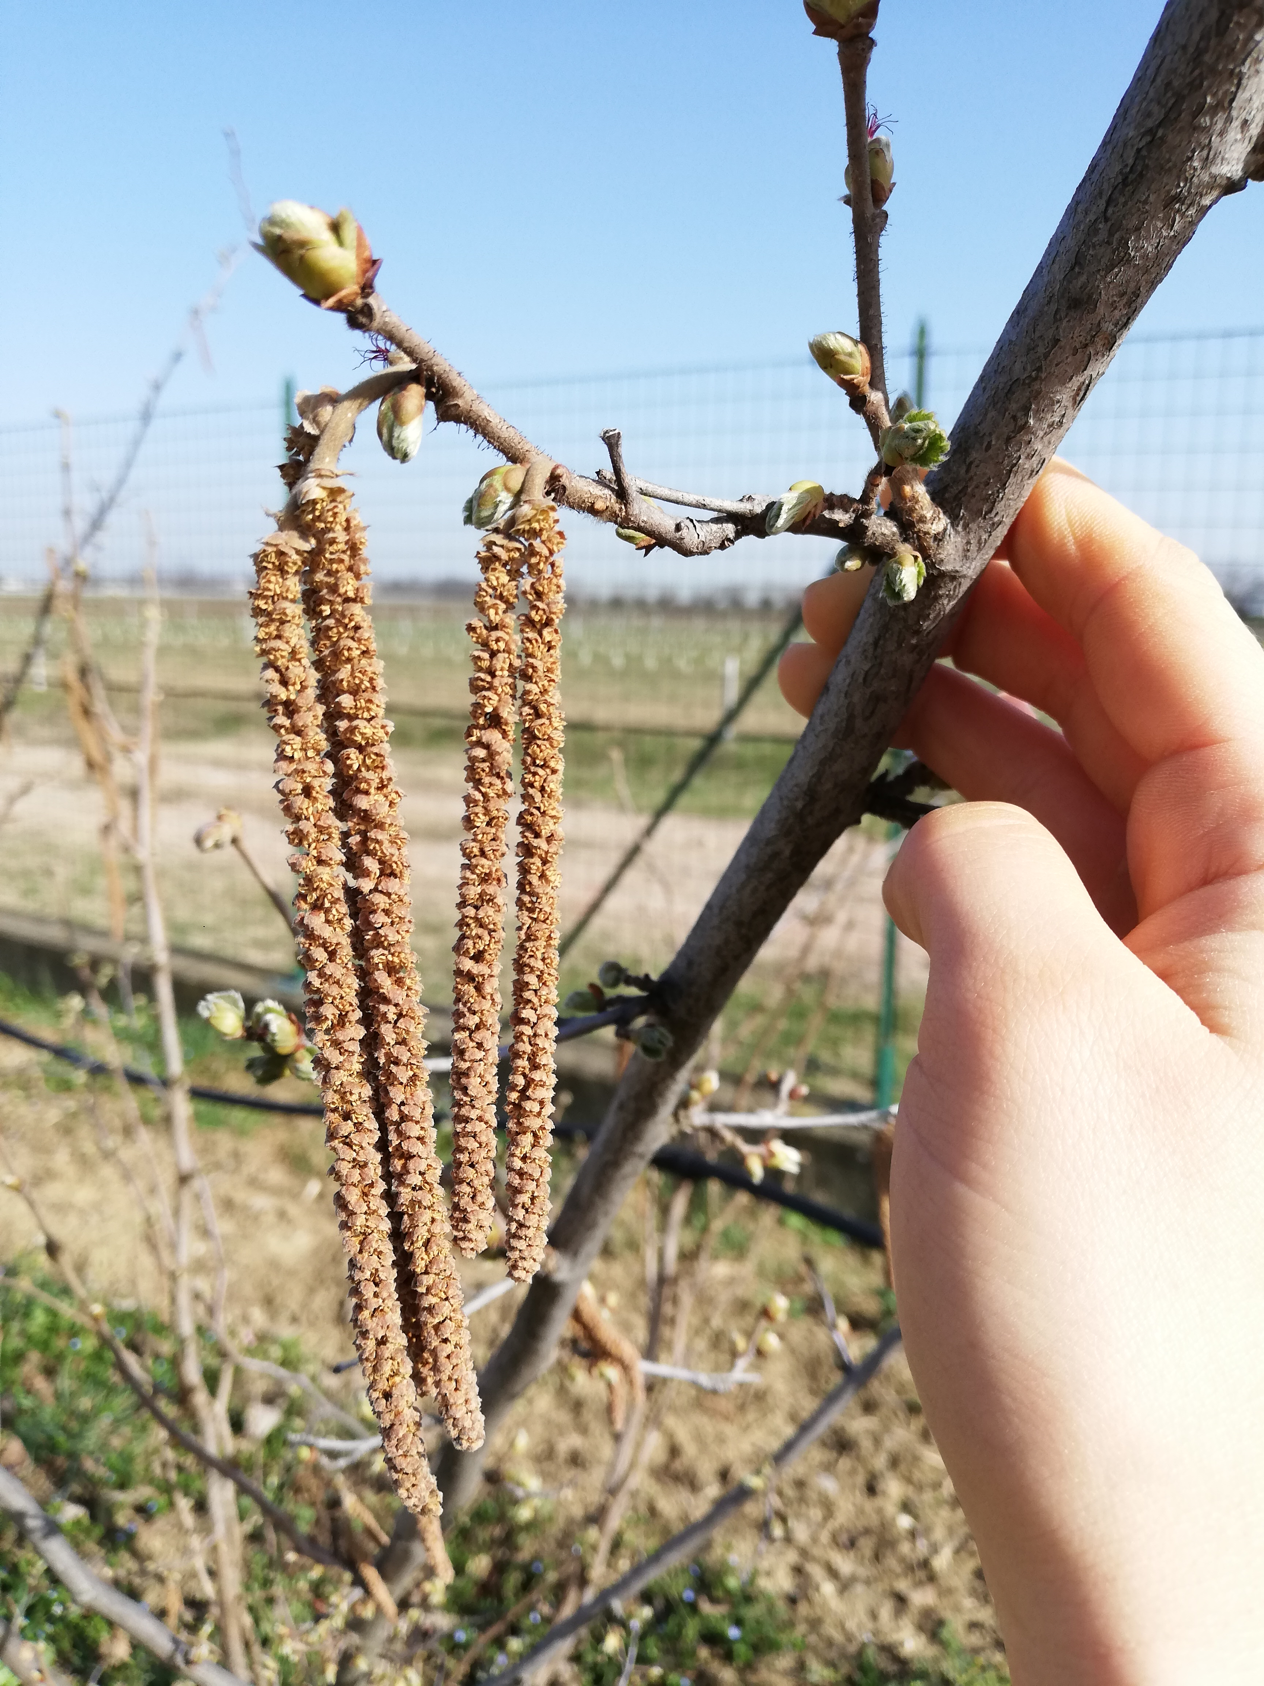
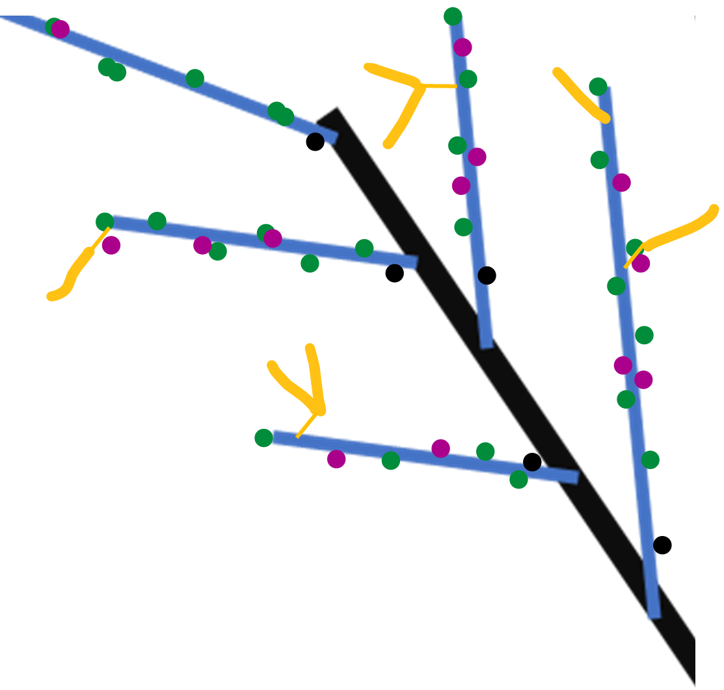
Winter observation
Year n
Year n
Proleptic shoot (referred to black)
Sylleptic shoot (referred to blue)
vegetative bud
Year n-1
Mixed bud
Blind node
catkin
SYLLEPTIC SHOOTS

Slide 4
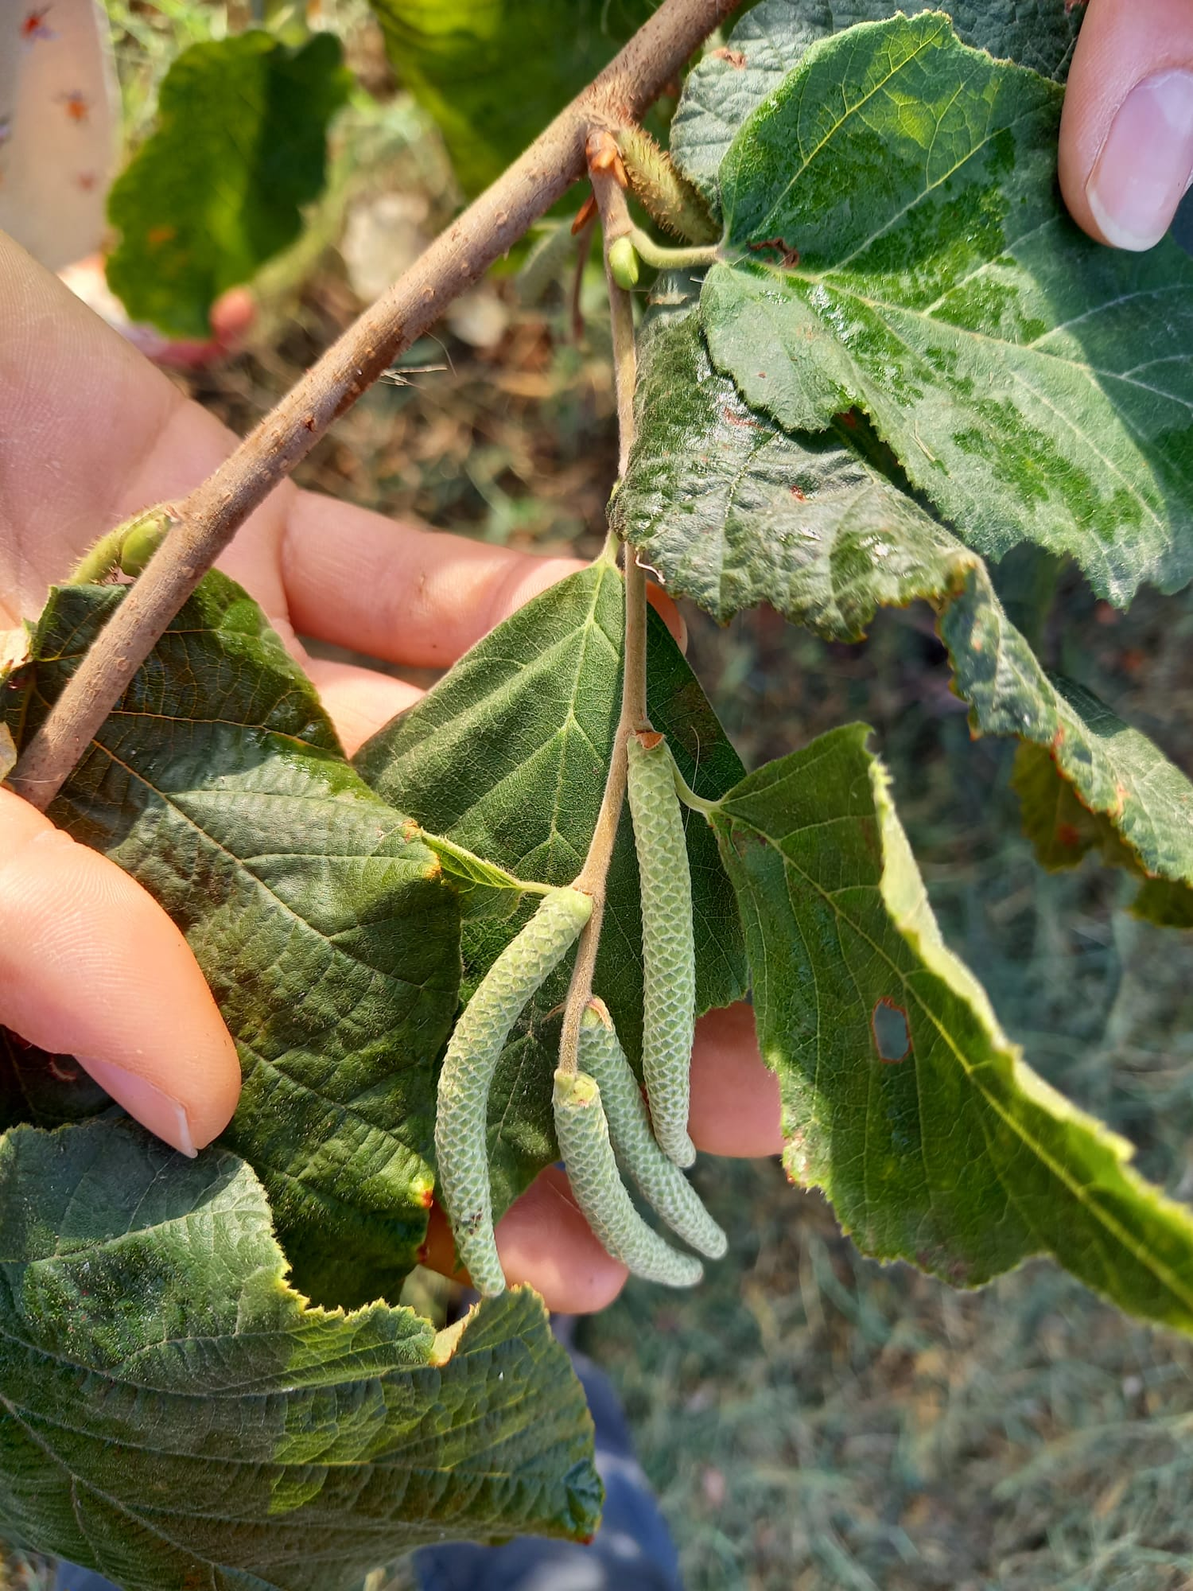
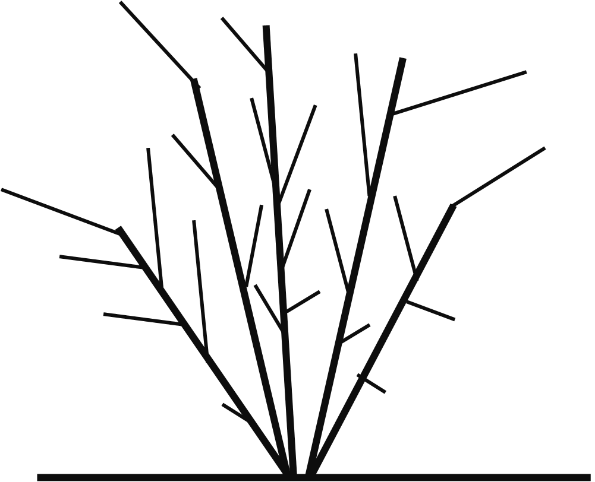
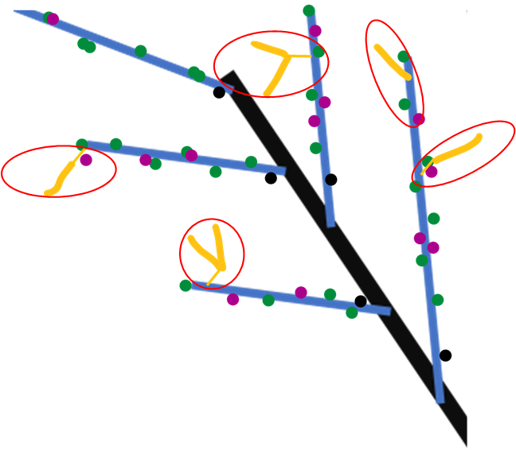

Spring growth
Year n+1
Year n+1
Year n
New proleptic shoot
Year n+1
Year n-1
New sylleptic shoot
Year n+1
leaves
SYLLEPTIC SHOOTS

Slide 5
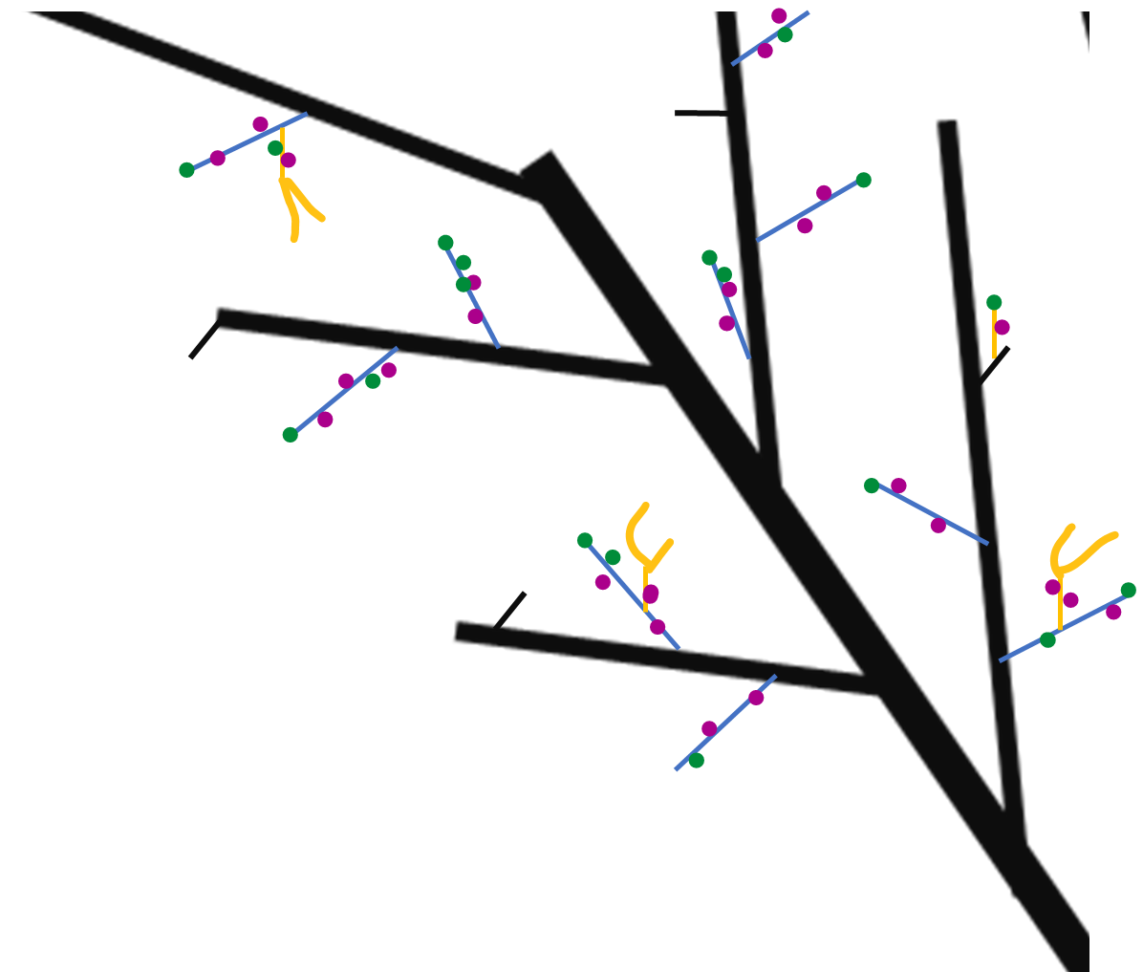
Next winter observations
Year n
Year n
Year n+1
Proleptic shoot
Year n+1
Sylleptic shoot
vegetative bud
Mixed bud
Year n-1
Blind node
catkin
SYLLEPTIC SHOOTS

Slide 6
GLMs
Markovian models
They are used to understand if a predictor describes a variable
Poisson if the variable is quantitative;
Binomial if the variable is categorical
Es. Is Vegetative bud burst (Y) depending on (~) length, rank node, sibling M, sibling V, tot buds at that rank?
They are used to understand if the variables (buds) can be grouped into homogeneus zones.
HAZELNUT ISSUES:
Dependencies between rank nodes;
Dependencies between buds at the same rank
NB_i glm sono delle generalizzazioni dei modelli lineari. Ipotizzando che le variabili possano essere distribuite anche in altri modi rispetto alla distribuzione normale

Slide 7
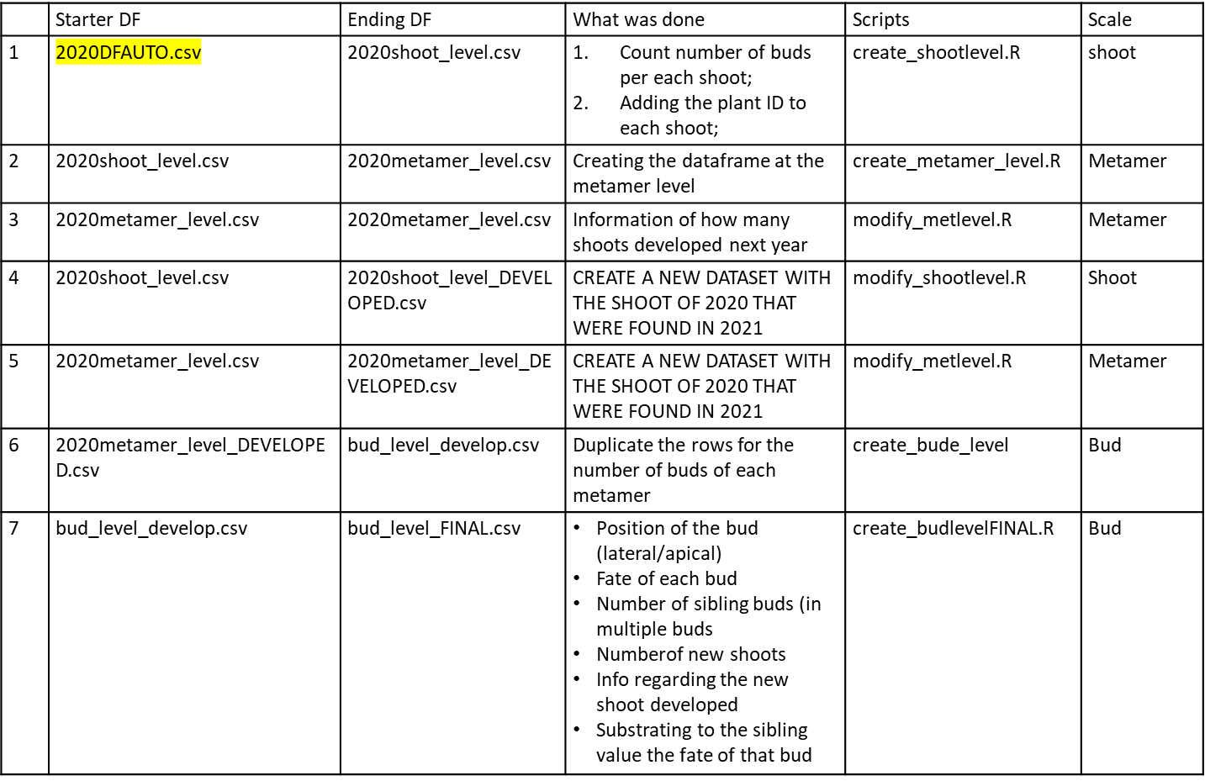
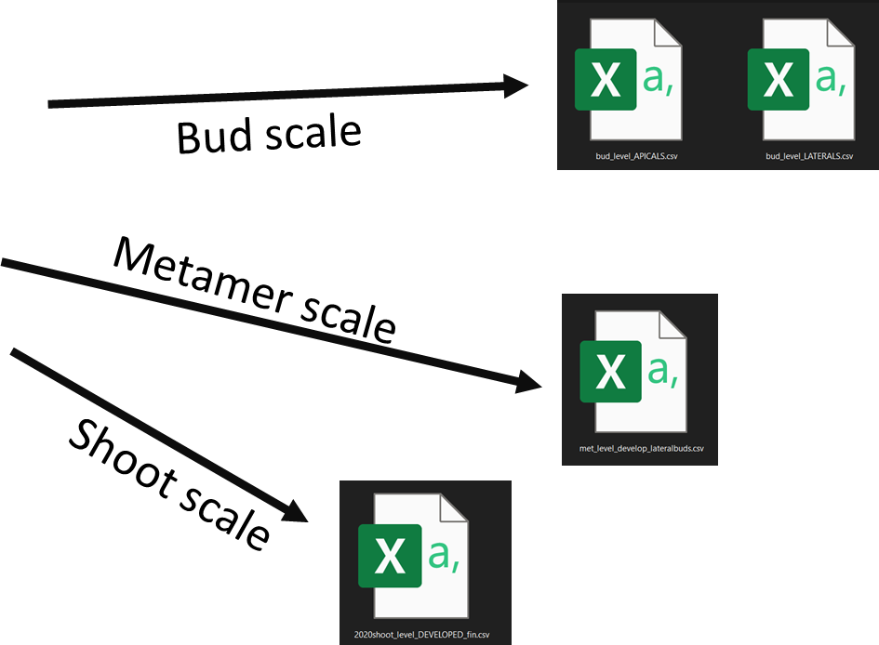
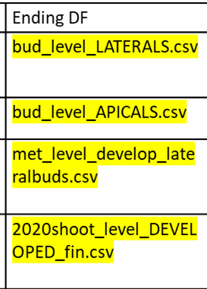
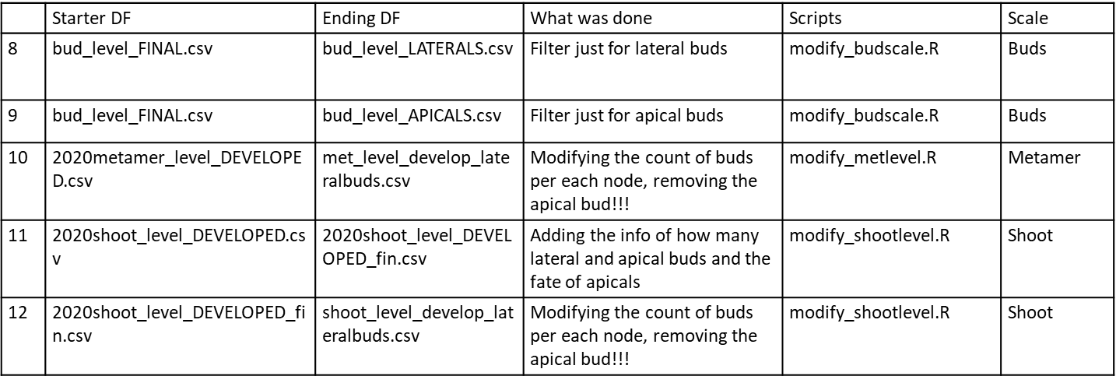
DATASET_ARCHITECTURE HAZELNUT
Process
OWN-ROOTED e INNE

Slide 8
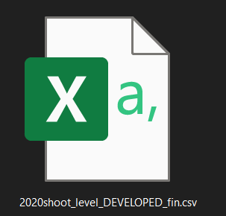
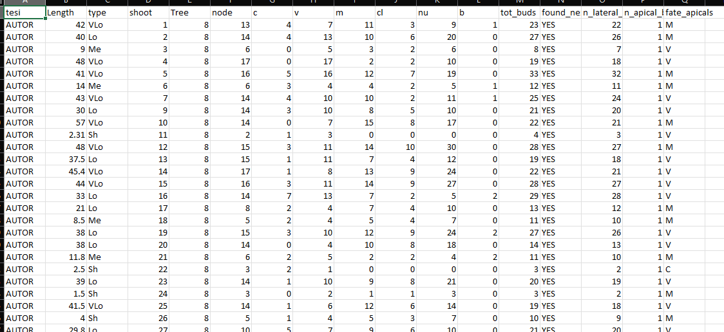
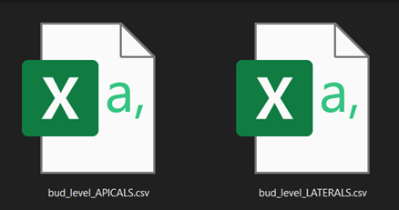
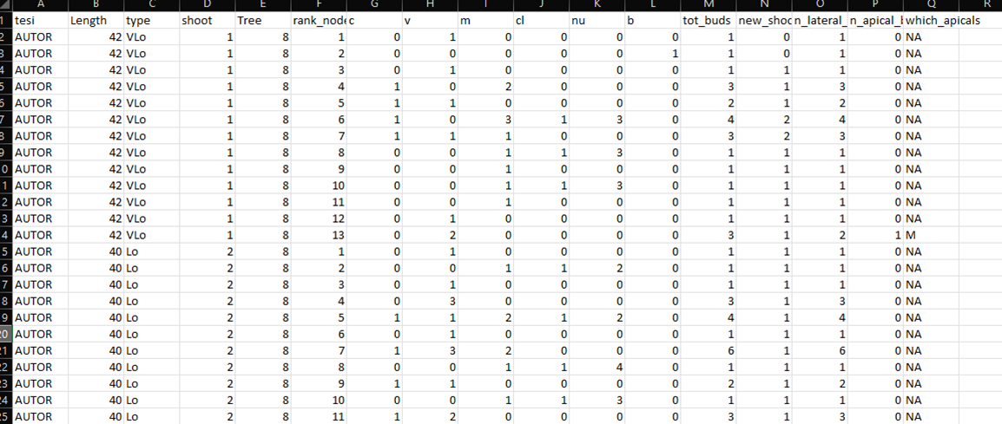
Shoot scale
Description of each shoot composition in terms of:
row ID
Not grafted
Plant ID mother of the shoot
Length(cm);
Length(class);
Number of nodes;
Number of buds per type (C,V,M,B);
Number of clusters;
Number of nuts;
Bud scale
Description of each bud composition in terms of:
New shoot ID
Year of parent sampling
Shoot ID
Shoot length(cm);
Metamer ID
Number of sibling buds at the same node(C,V,M,B);
Total buds per node;
Number of Shoots developed at that rank;
Fate of bud (one per each row)
Position of the bud (apical/lateral)
Length of new shoot(cm)
Length of new shoot(class)
Information regarding each new shoot composition

Slide 9
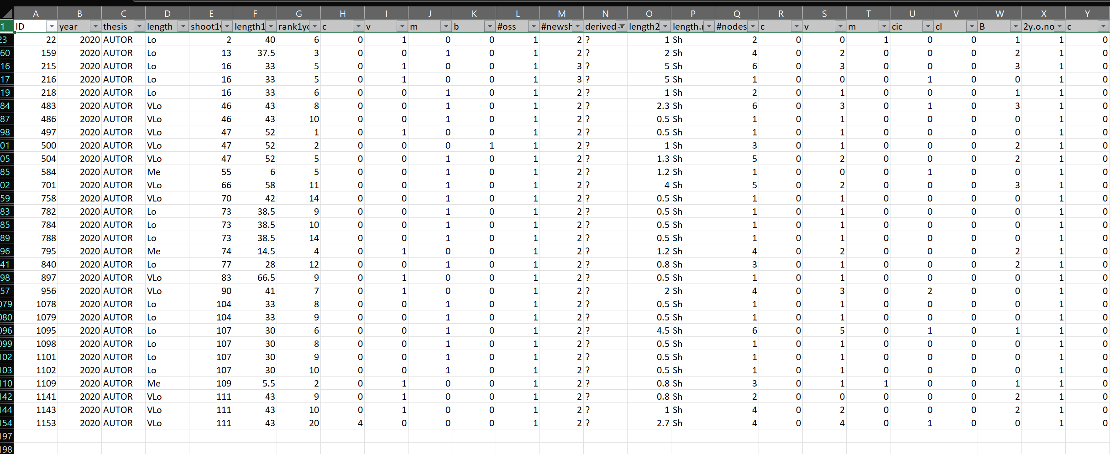
The original «new_shoots» file has the same information of the bud fate scale(in terms of new shoots details) plus it contains some the errors.
Errors= new shoots that i can’t explain from where they came from. Assigned as «?»
These errors impact less than 3% on the totals, so i guess we can ignore them and use the bud_scale file also for new shoots. What do you thing?

Slide 10
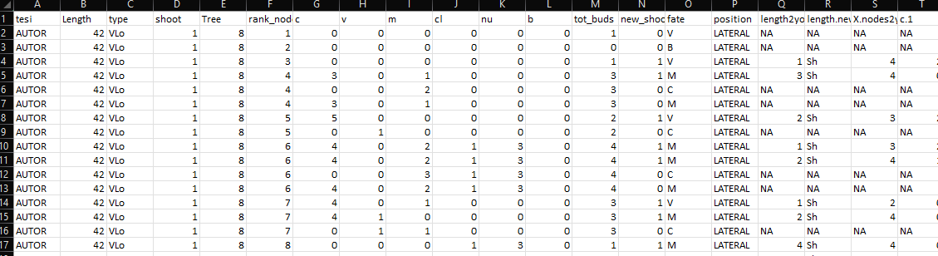
GLMs example
glm(Y~F1+F2+F3+F4+F5+F6+F7, family=«binomial»)
PREDICTORS
Two GLMs:
For fate=V
For fate=M
F1
F2
F3
F4
F5
F6
F7
Y
How to Interpret glm Output in R (With Example) - Statology

Slide 11
Problems & solutions
Several predictors mask their effects (ES. NA values)
Run different GLMs avoid each time a predictor:
Y~tot_buds+length+rank
Y~M+V+C+length+rank
p. Value are significant because we have many data. Is real significance?
Permutation models + difference in AIC

Slide 12
Permutation models
RM=GLMS(Y~A+B+C, data=DF)
Shows that A is really significant (***).
To be more sure that it is really significant, it necessary to do permutation models.
LOGIC:
the AIC of real model (RM= Y~A+B+C) should be LOWER (better) than the null model (NM= Y~B+C+1).
Compute RM-NM=q? YES (q should be <0)
But it could be a casuality. We have to permute A (shuffled) 10000 run again RM_shuf=(Y~A(shuffled)+B+C)
RM_shuf-NM=t
how many times t<q??. If t is < q it means that RM_shuf better explain the model!!!
If t<q in 0.01% of the permuted trials (significance = 1%) we can conclude that A has an effect on Y!!

Slide 13
Make GLMs
ADDING METHOD
Find dipendent variable (Y) and predictor (A). NB_start with 1 predictor and if it is significant, add the others.
Run the model glm(Y~A)
Is A significant?
No. → Stop. Try another predictor (B);
Yes. → permutation model cofirm?
Find another predictor (B);
Run the glm (Y~A+B)
Is B significant?
No. → stop. Try with another predictor (C);
Yes→permutation model cofirm?
Continue like this with all predictors

Slide 14
Make GLMs
SUBTRACTING METHOD
Find dipendent variable (Y) and predictors (A,B,C). NB_start with ALL predictorS and DISCARD THE LESS SIGNIFICANT USING THE PERMUTATIONS MODEL AND P-VALUE OF GLMS
Run the model glm(Y~A+B+C)
Exclude the predictor less significant
Try different combinations (Y~A+B; Y~A+C, Y~B+C)
An alternative way is to use the function step() with glm. It will automatically check the predictor with lower AIC (step function – Rdocumentation) tutorial in : 2101f11StepwiseLogisticR (toronto.edu)
dredge function – Rdocumentation → function in R that select the best model to fit

Slide 15
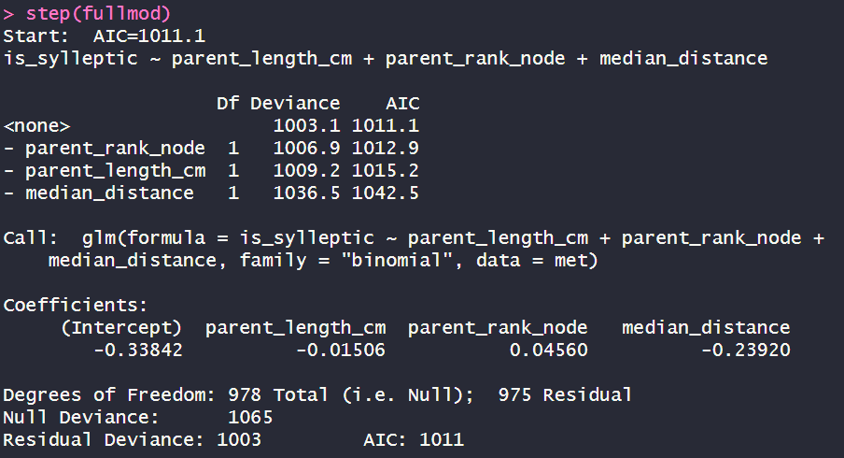
Step()
>fullmod= glm(Y~A+B+C)
>summary(fullmod)→ in questo modo vedi i risultati in termini di Estimate (probabilità, significatività (***) e l’ AIC (più piccolo è meglio è)
Inserendo Mod nella funzione step accade questo:
>step(fullmod)
1. AIC di partenza con tutti e tre i parametri
2. Se il modello mantiene tutti e tre i parametri. L’AIC è 1011.1
3. Se il modello toglie «parent_rank_node». L’AIC è 1012.9 quindi più alto e quindi peggiore
4. Se il modello toglie «parent_length_cm». L’AIC è 1015.2 quindi più alto e quindi peggiore
5. Se il modello toglie «median_distance». L’AIC è 1042.5 quindi più alto e quindi peggiore
Quindi in sostanza, quello con tutti e tre i parametri è il migliore!!

Slide 16
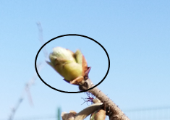
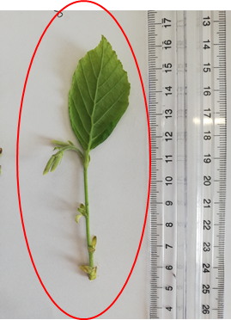

First approach to modelling
Box0:
How many nodes in that shoot
Box1:
Does that rank bear a sylleptic?
NO
Box1.0: how many buds(b,v,m)?
YES
Box2: how many V and M buds?
Box3: proportion of B?
Box3: proportion of V?
Box3: proportion of M?
Box3: proportion of V ?
Box4: do you burst?
Box:3.1Proportion of M?
Box4: do you burst?
Box5: How many nodes OF NEW SHOOTS?
Box5: How many nodes OF NEW SHOOTS?

Slide 17
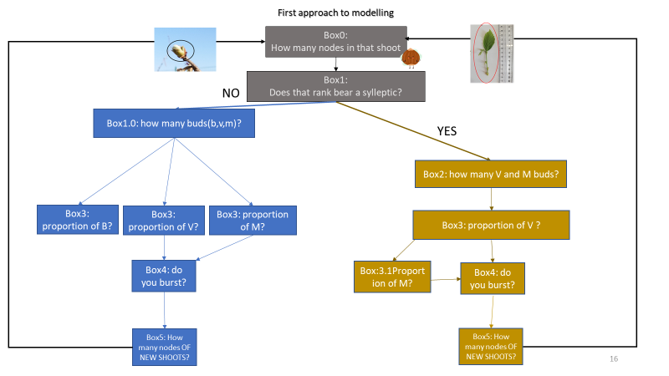
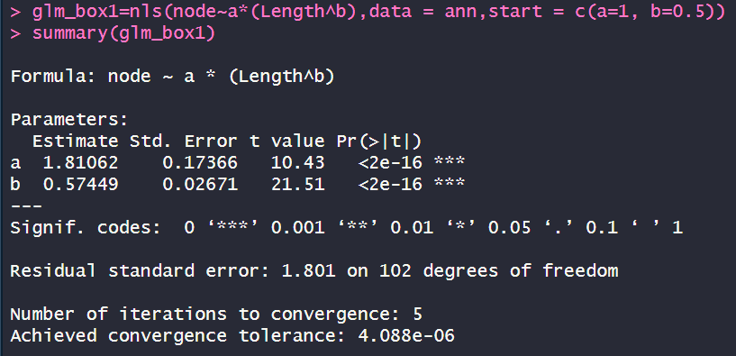
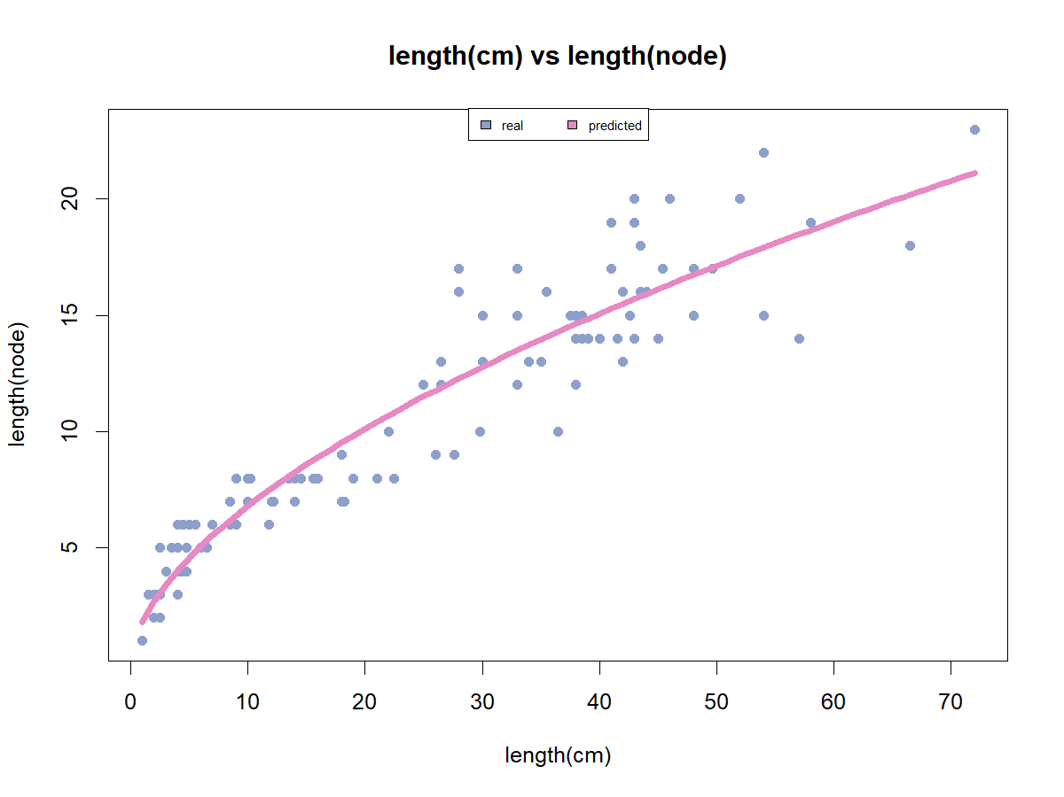
Box0:
How many nodes in that shoot

Slide 18
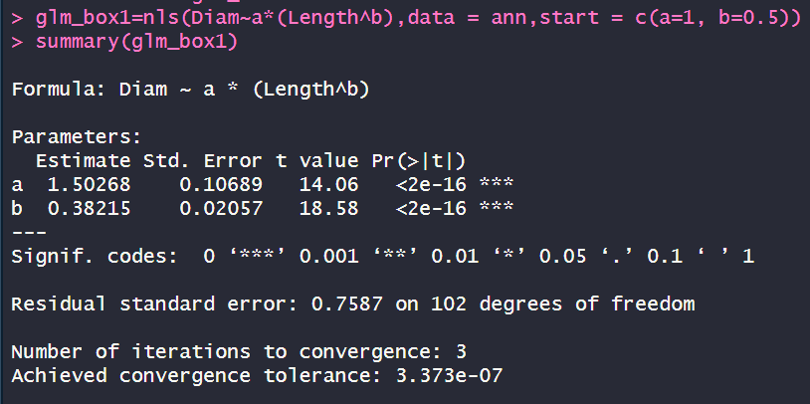
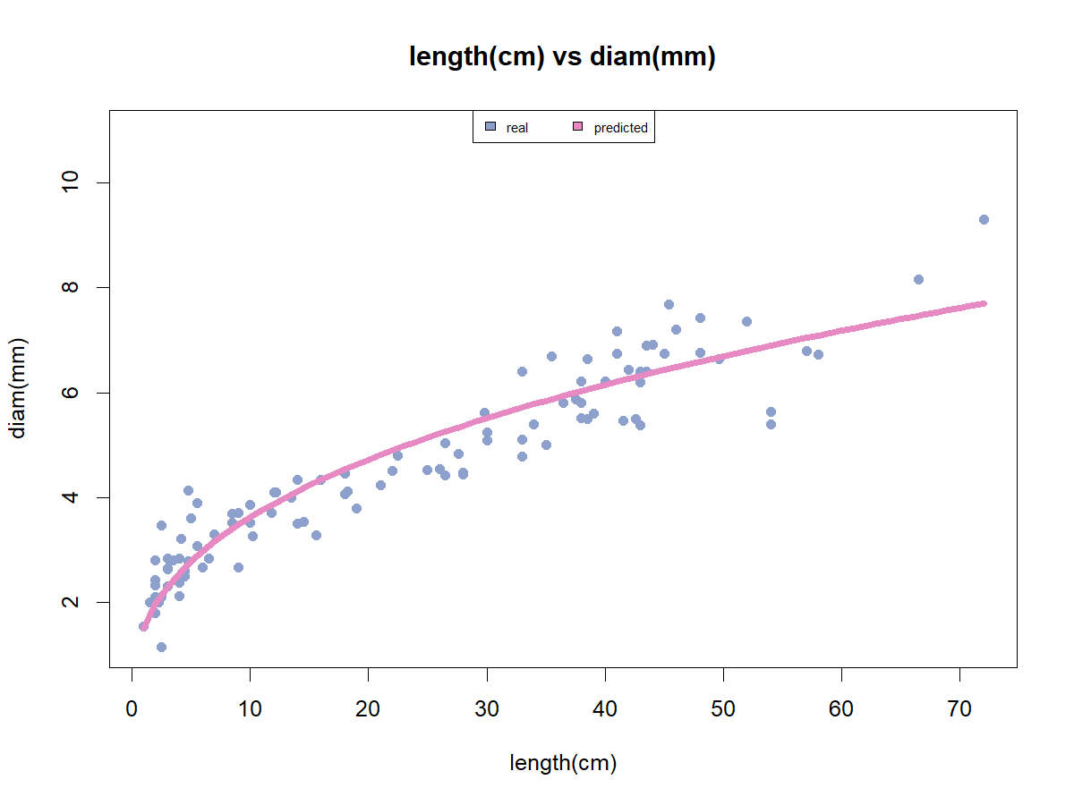
Relations

Slide 19
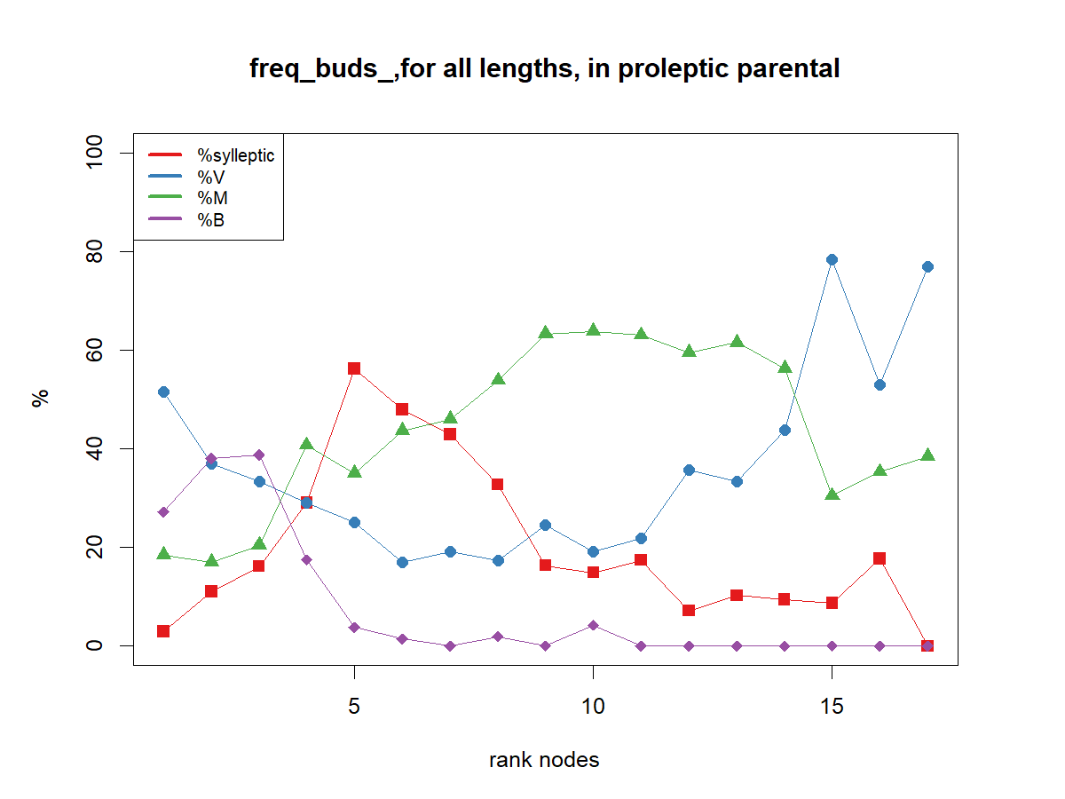
Because sylleptic are distributed in the median zone along the parent shoot, the rank does not have a linear effect:
we compute for each bud the distance to the shoot extremities,
0 is the median rank of each shoot

Slide 20
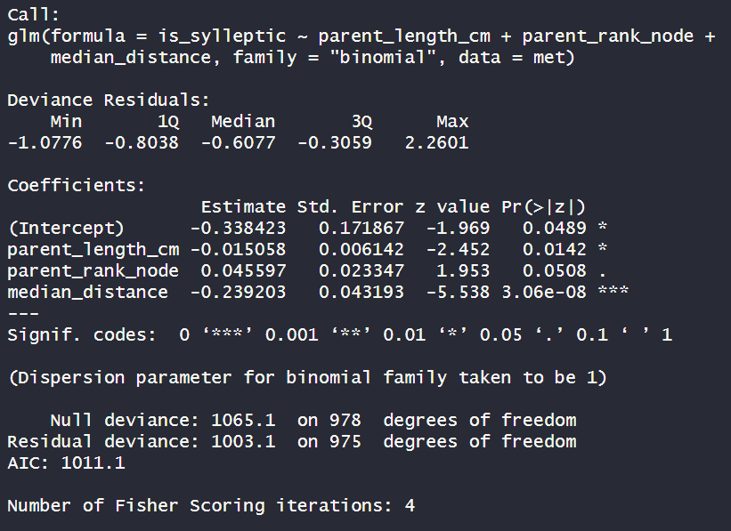
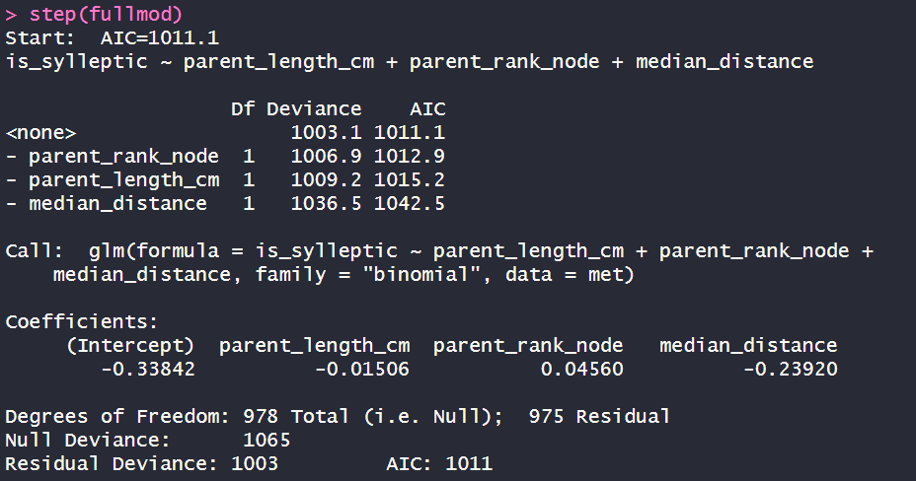
Box1: Does that rank bear a sylleptic?
~length(cm)+rank_node+distance
Length significant(*). Coef=-0.01
Rank node is not significant
Distance is significant (***). Coef=-0.23
AIC=1011.1
It seems to be the best model. Also confirmed by STEP

Slide 21
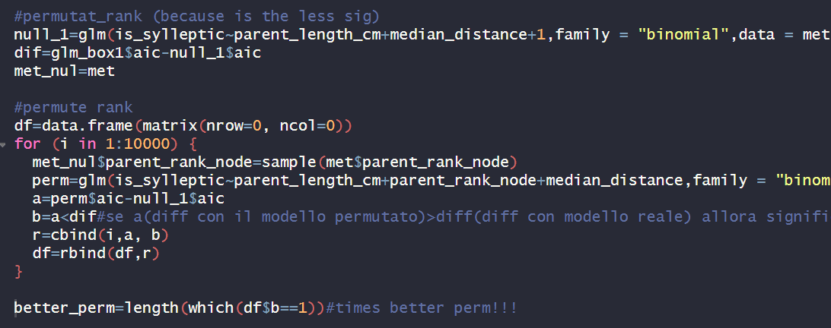
Box1:Does that rank bear a sylleptic?
Permuting
rank node
497 times out of 10000 the aic of null model- aic of permutated ones was greater than the difference with real model (~5%)
because the probability that rank node explain by chance the model is ~5% (>1% of significance) we remove rank node from the equation

Slide 22
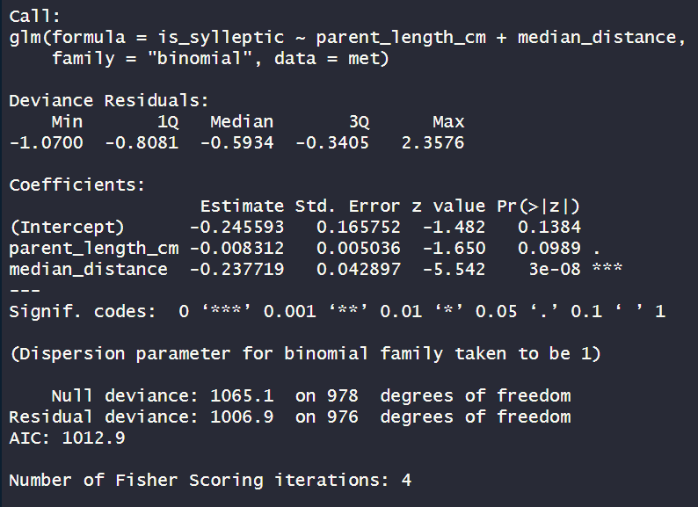
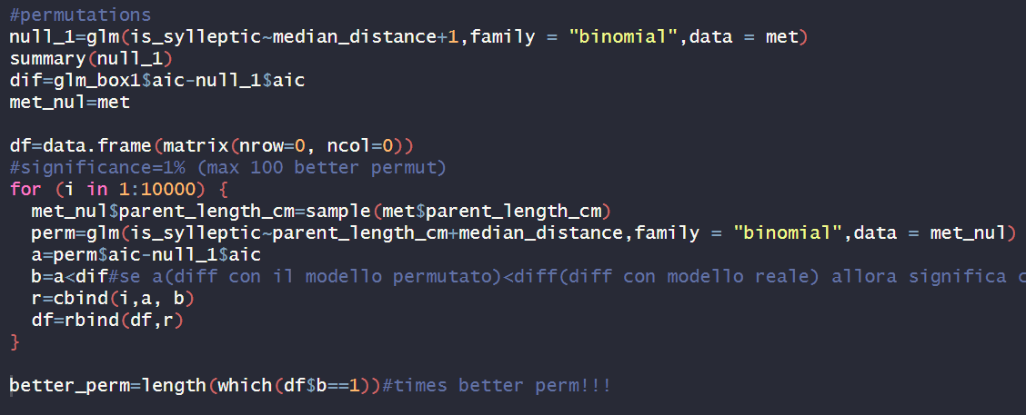
Box1:Does that rank bear a sylleptic?
~parental_length(cm)+distance
Length is not significant
distance is significant(***).Coef=-0.23
AIC=1012.9
AIC WORSE AND PERMUTATION WORSE THAN PREVIOUS
1006 times out of 10000 the aic of null model- aic of permutated ones was greater than the difference with real model!!! ~ 10%
because the probability that LENGTH explain by chance the model is ~10% (>1% of significance) we remove length from the equation

Slide 23
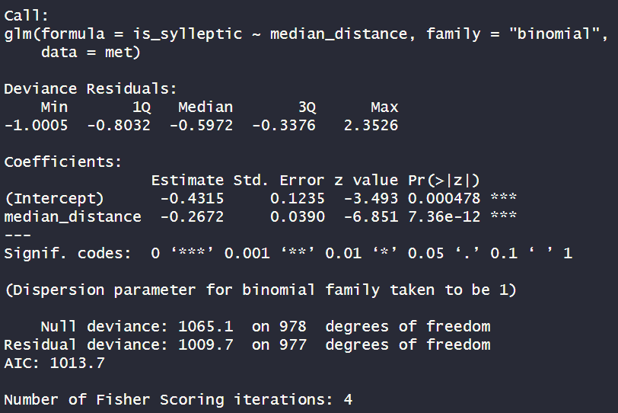
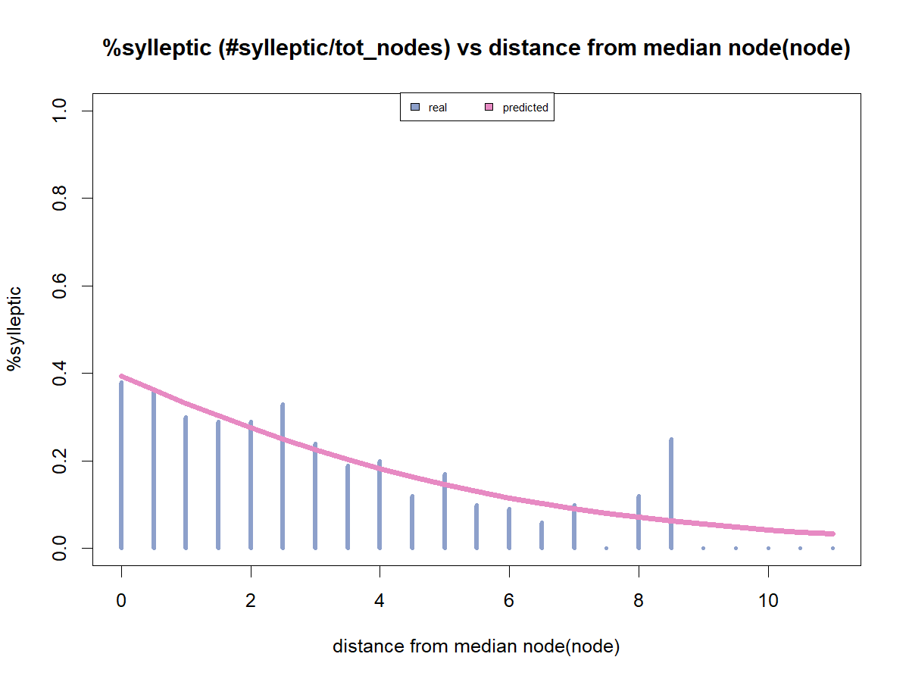
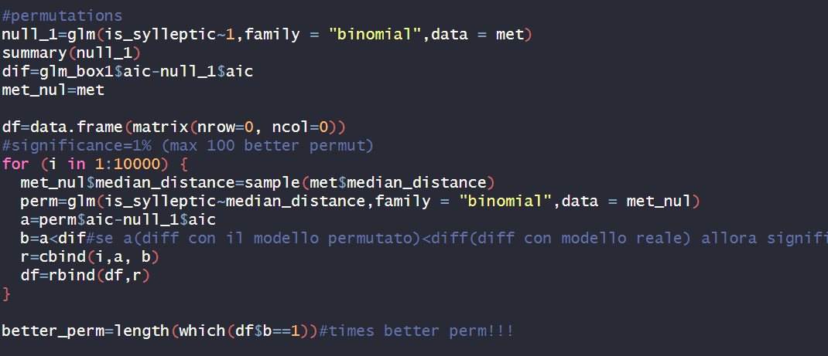
distance is significant(***).Coef=-0.27
Box1:Does that rank bear a sylleptic?
~distance
AIC=1013.7
AIC WORSE BUT PERMUTATION BETTER THAN PREVIOUS
0 times out of 10000 the aic of null model- aic of permutated ones was greater than the difference with real model!!! ~ 0%

Slide 24
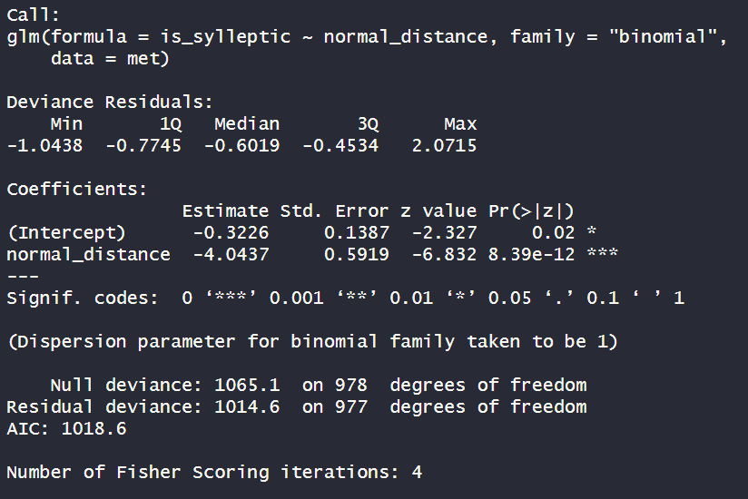
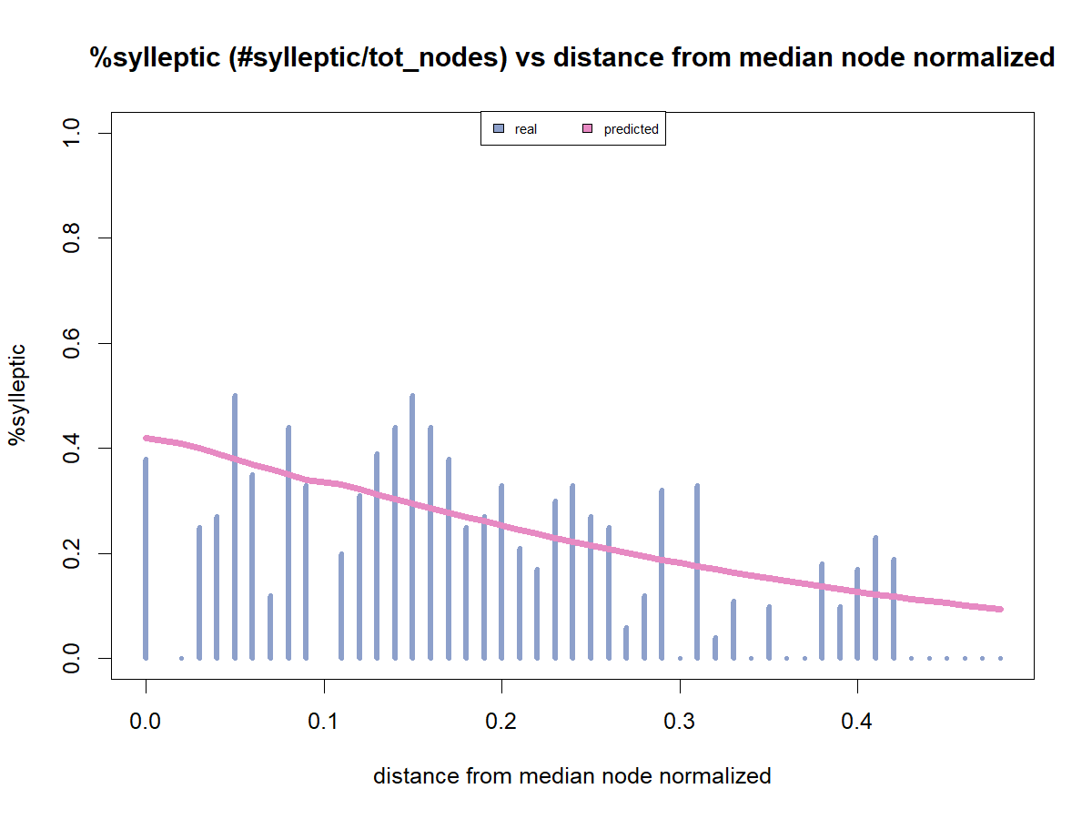
Box1:Does that rank bear a sylleptic?
~distance normalized (distance/tot nodes)
distance is significant(***).Coef=-4.04
AIC WORSE
AIC=1013.7
0=median part
0.5=end/beginning

Slide 25
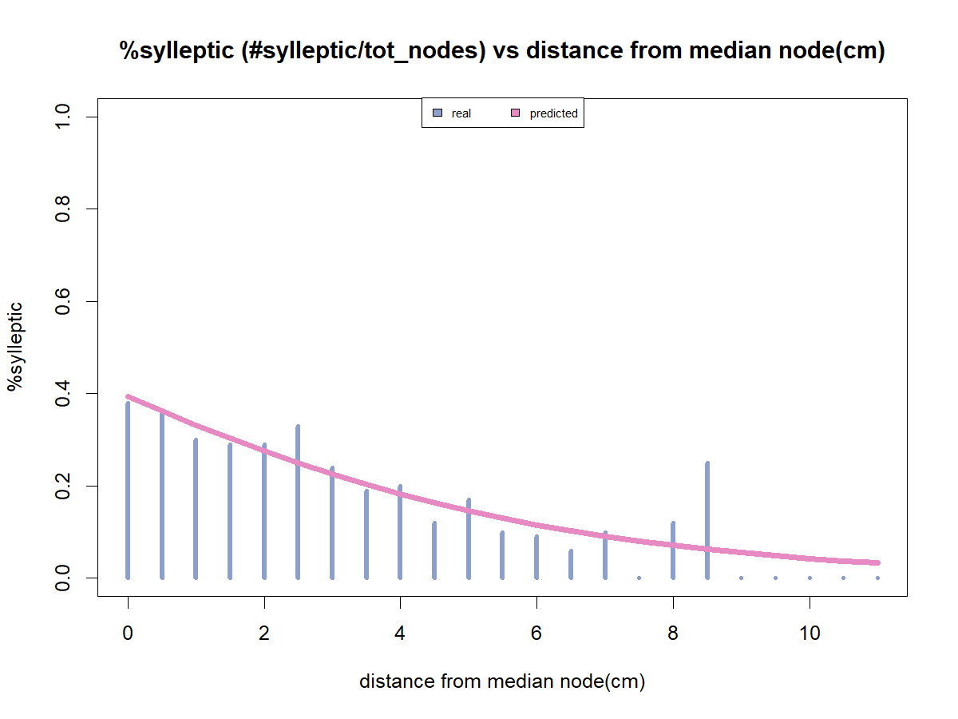
First approach to modelling
Box0:
How many nodes in that shoot
~Distance
Box1:
Does that rank bear a sylleptic?
NO
Box1.0: how many buds(b,v,m)?
YES
Box2: how many V and M buds?
Box3: proportion of B?
Box3: proportion of V?
Box3: proportion of M?
Box3: proportion of V ?
Box4: do you burst?
Box:3.1Proportion of M?
Box4: do you burst?
Box5: How many nodes OF NEW SHOOTS?
Box5: How many nodes OF NEW SHOOTS?

Slide 26
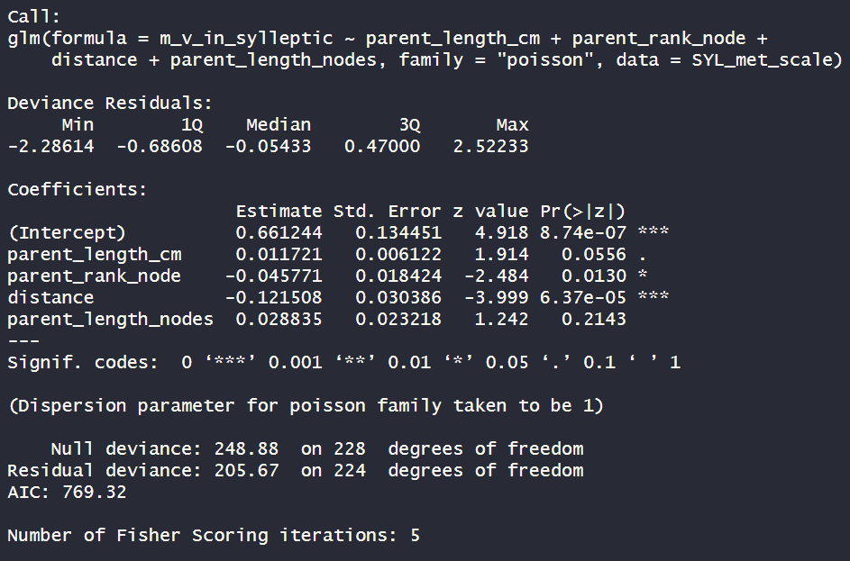
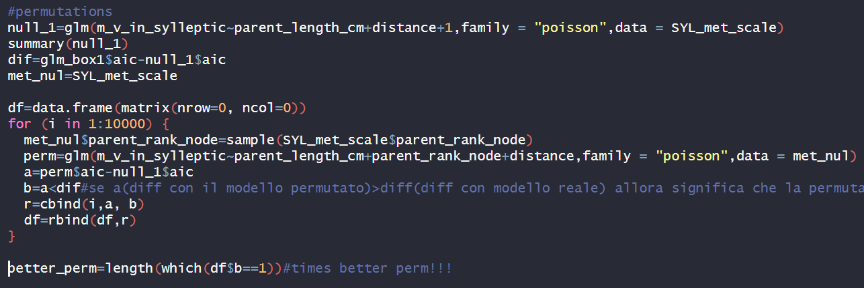
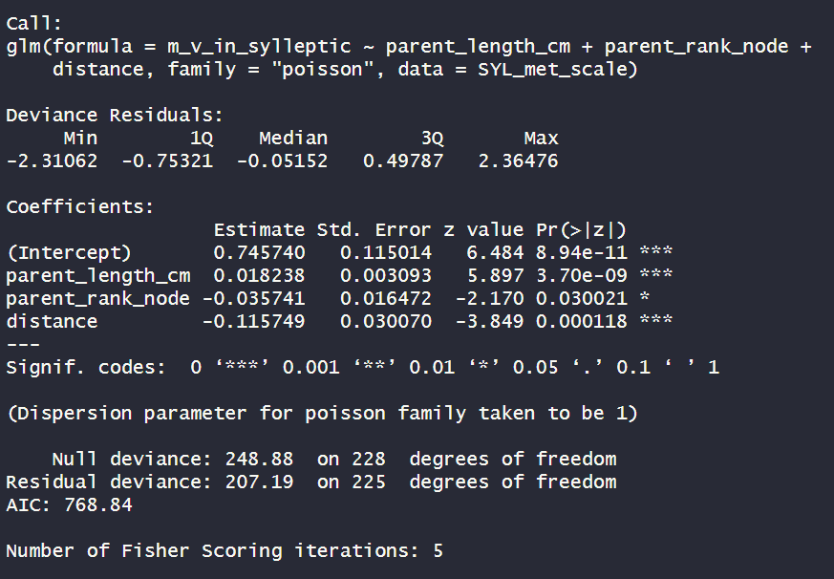
Box2: how many V and M buds?
~parent shoot length(cm)+rank+distance+length(node)
Length is not significant;
Rank is significant(*).Coef=-0.05
Distance is significant(***).Coef=-0.12
Length(node) is not significant
Length is significant(***).Coef=0.02
Rank is significant(*).Coef=-0.04
Distance is significant(***).Coef=-0.12
remove parent length(node)
Permute rank_node
AIC=769.32
120 times out of 10000 the aic of null model- aic of permutated ones was greater than the difference with real model!!! ~ 1.2%
AIC=768.84
AIC BETTER
because the probability that RANK explain by chance the model is ~1.2% (>1% of significance) we remove RANK from the equation

Slide 27
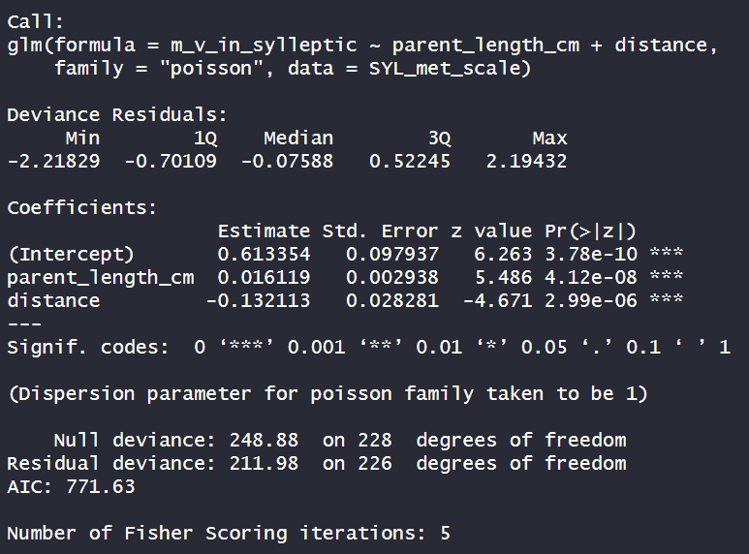
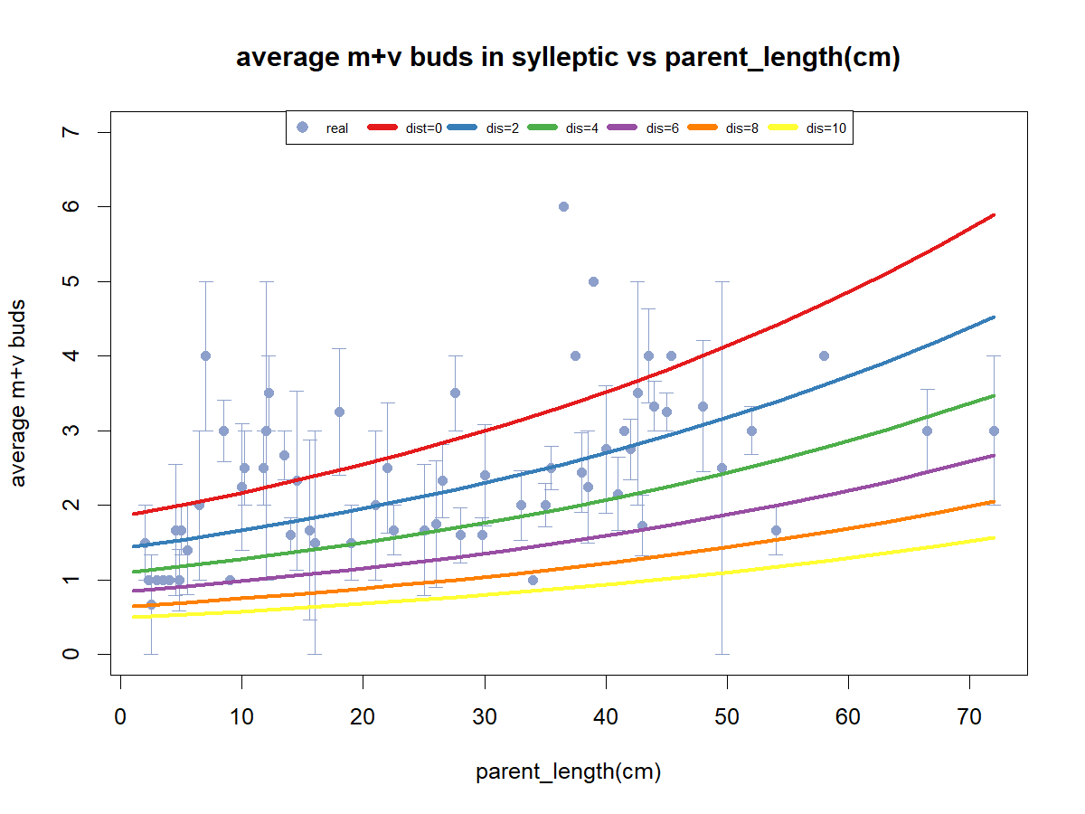
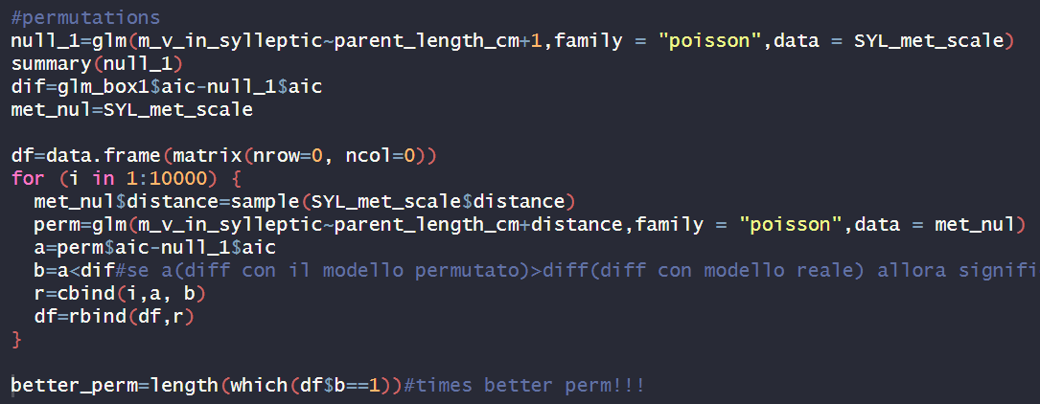
Box2: how many V and M buds?
~parent shoot length(cm)+distance
Length is significant(***).Coef=0.02
Distance is significant(***).Coef=-0.13
Permute DISTANCE
AIC=771.63
AIC WORSE BUT PERMUTATION BETTER
0 times out of 10000 the aic of null model- aic of permutated ones was greater than the difference with real model!!! ~ 0%

Slide 28
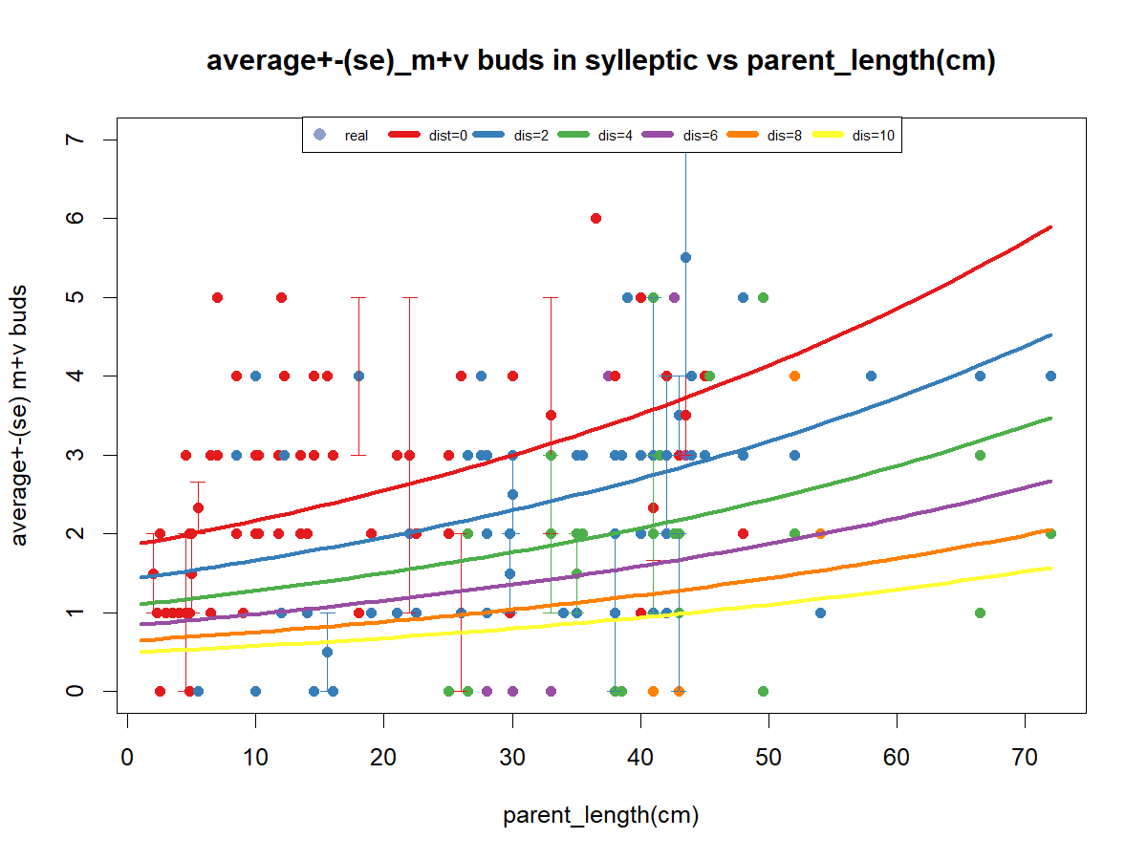
Distance from the median node

Slide 29
First approach to modelling
Box0:
How many nodes in that shoot
~Distance
Box1:
Does that rank bear a sylleptic?
NO
Box1.0: how many buds(b,v,m)?
YES
~length_cm+Distance
Box2: how many V and M buds?
Box3: proportion of B?
Box3: proportion of V?
Box3: proportion of M?
Box3: proportion of V ?
Box4: do you burst?
Box:3.1Proportion of M?
Box4: do you burst?
Box5: How many nodes OF NEW SHOOTS?
Box5: How many nodes OF NEW SHOOTS?

Slide 30
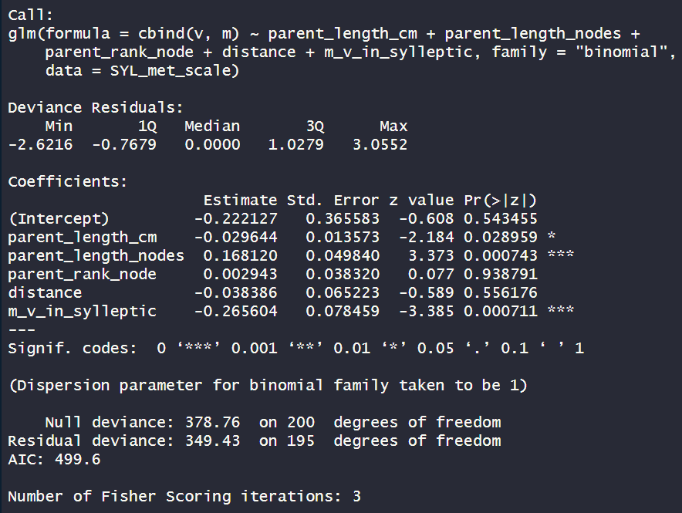
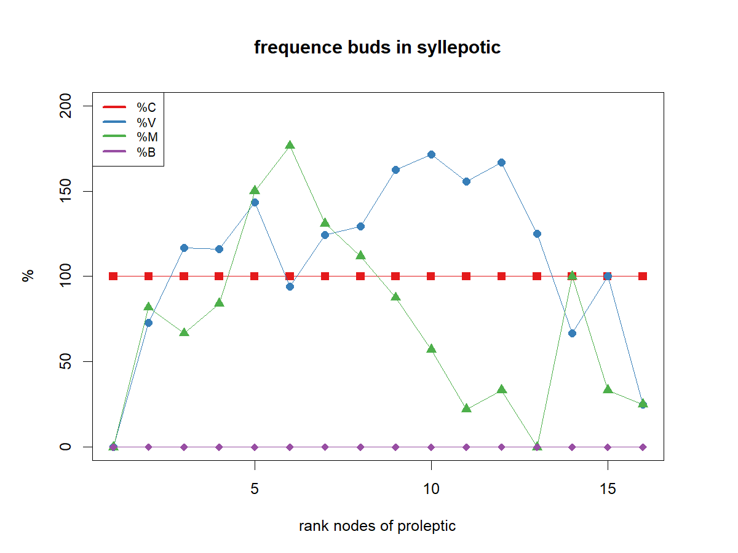
Box3: proportion of V ?
~length(cm)+length(node)+rank node+distance+m_v
Length (cm)is significant(*). Coef=-0.03
Length(nodes) is significant(***). Coef=0.17
Rank is not significant
Distance is not significant
M_v is significant (***). Coef=-0.26
I remove rank
In the pic above it seems that parent rank node has an effect but actually not
AIC=499.6

Slide 31
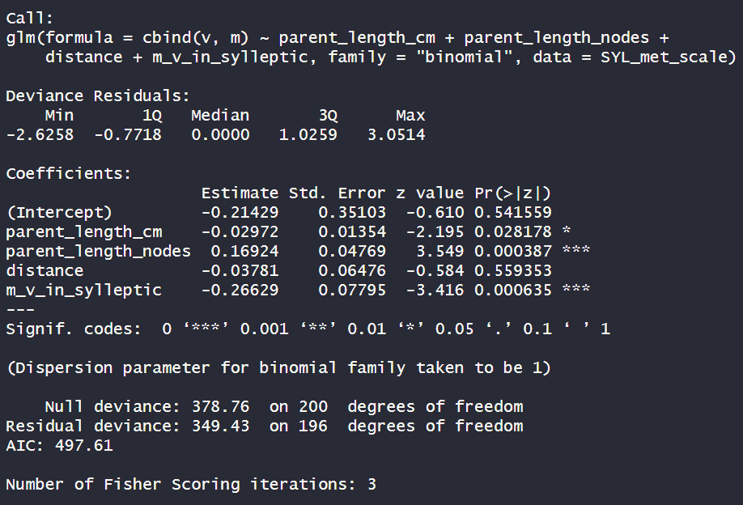
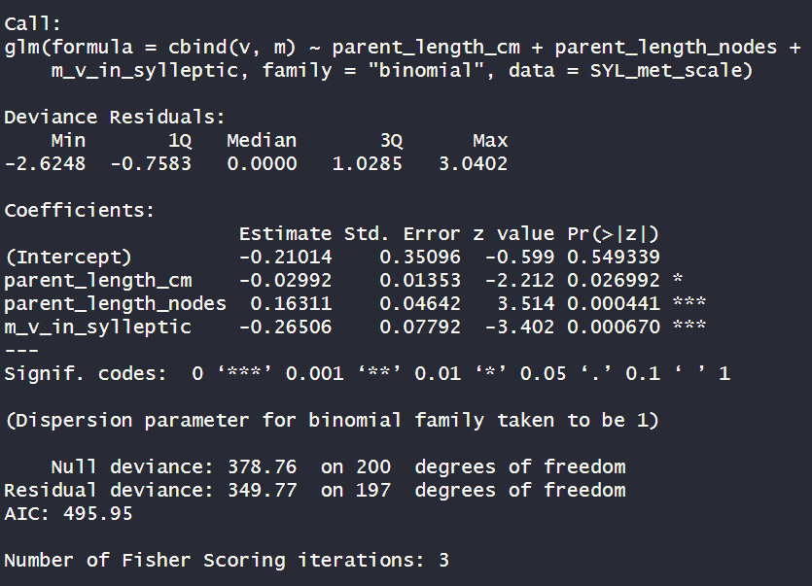
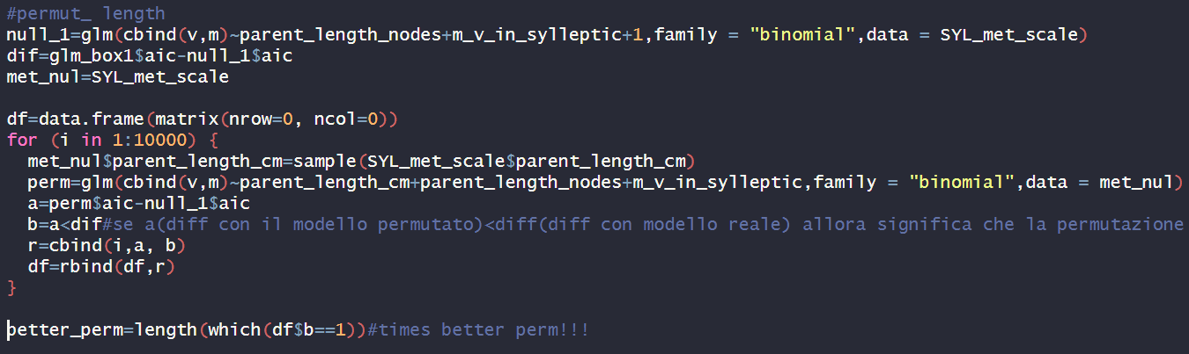
Box3: proportion of V ?
~length(cm)+length(node)+distance+m_v
Length (cm)is significant(*). Coef=-0.03
Length(nodes) is significant(***). Coef=0.17
Distance is not significant
M_v is significant(***).Coef= -0.27
Length (cm)is significant(**). Coef=-0.03
Length(nodes) is significant(***). Coef=0.17
M_b is significant(***).Coef=-0.27
Permute length(cm)
AIC=497.61
AIC BETTER
I remove distance
764 times out of 10000 the aic of null model- aic of permutated ones was greater than the difference with real model!!! ~ 8%
AIC BETTER
AIC=495.95
because the probability that LENGTH explain by chance the model is ~8% (>1% of significance) we remove length from the equation

Slide 32
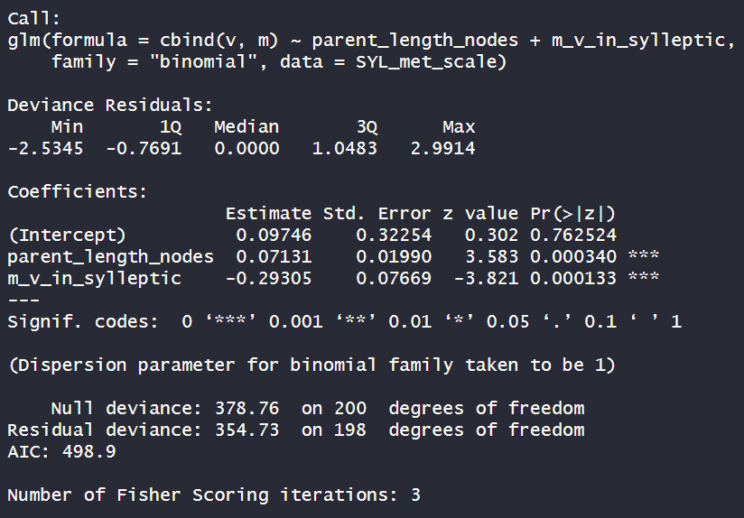
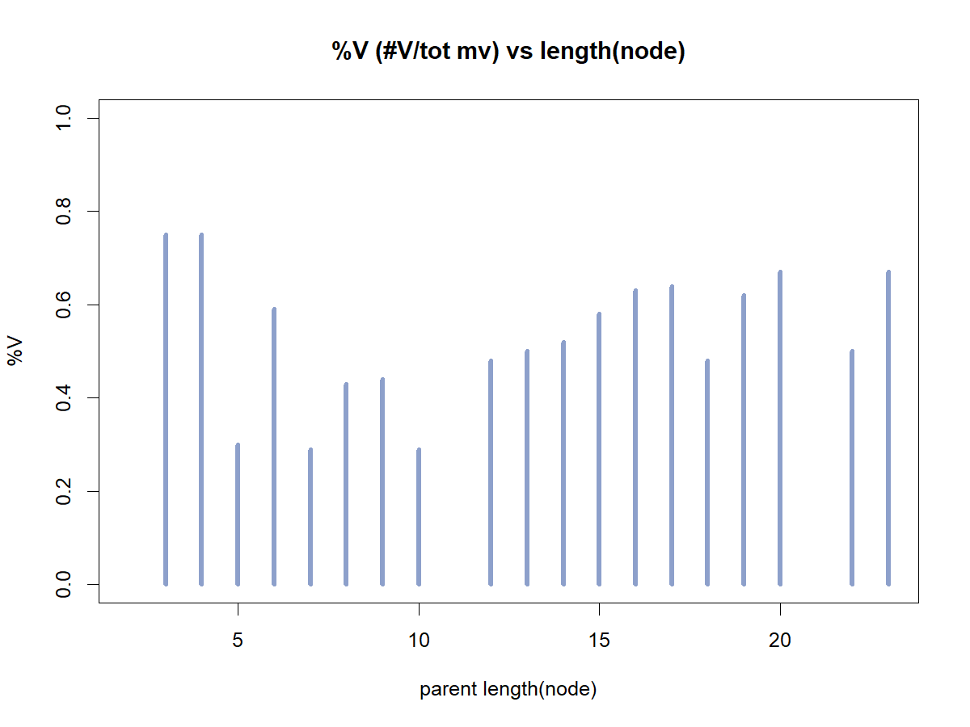

Box3: proportion of V ?
~length(node)+m_v
Length(nodes) is significant(***). Coef=0.07
M_b is significant(***).Coef=-0.29
Both graphs are not very explicative
and because the parameters are associatet with parent and not with sylleptic itself, we consider %V as a constant
AIC=498.9
AIC WORSE

Slide 33




Box3: proportion of V ?
Box3: proportion of V ?
~ length(node)
Proportion of V in sylleptic as a constant (0.55±0.02)
Proportion of V in sylleptic as a constant (0.55±0.02)
Discriminate predicted VS real

Slide 34
First approach to modelling
Box0:
How many nodes in that shoot
~Distance
Box1:
Does that rank bear a sylleptic?
NO
Box1.0: how many buds(b,v,m)?
YES
~length_cm+Distance
Box2: how many V and M buds?
V=constant: (0.55±0.02)
Box3: proportion of B?
Box3: proportion of V?
Box3: proportion of M?
Box3: proportion of V ?
M=constant: 1-(0.55±0.02)
Box4: do you burst?
Box:3.1Proportion of M?
Box4: do you burst?
Box5: How many nodes OF NEW SHOOTS?
Box5: How many nodes OF NEW SHOOTS?

Slide 35


From M+V
Box4: do you burst?
~fate+length(cm)+ length(nodes)+ fate* distance+ fate* rank+ fate* m+ fate* v
New shoots (1=present, 0=absent), from V buds, related to parent length in sylleptic shoots
I remove LENGTH_NODE
Interpretation:
Fate1:v is not sig thus it means it is not different from the standard (fate0:v).
I remove rank_NODE
AIC=670.81
AIC=666.83

Slide 36



From M+V
Box4: do you burst?
~fate+fate*length(cm)+ fate* distance+ fate* m+ fate* v
New shoots (1=present, 0=absent), from V buds, related to parent length in sylleptic shoots
I remove distance
Permute length
AIC=663.04
AIC=667.78
352 times out of 10000 the aic of null model- aic of permutated ones was greater than the difference with real model!!! ~ 4%
remove length

Slide 37


From M+V
Box4: do you burst?
~fate+fate* m+ fate* v
New shoots (1=present, 0=absent), from V buds, related to parent length in sylleptic shoots
Exp(coef)
Exp(coef)/1+Exp(coef)
The average bursting of FATE V is exp(1.40)/1+exp(1.40)=80%
the fate M has lower % of bursting by a factor of 80%*40%=30%compared to fate V. NS
in fate V, we expect a decrease % of bursting by a factor 80%*44%=35% every increase of “m” NS
in fate V, we expect a decrease % of bursting by a factor 80%*34%=27% *every increase of “v” (***)
the fate M, with M buds has lower % of bursting by a of 80%*39%= 31% compared to fate V. (*)
the fate M, with V buds has lower % of increase by a of 80%*59%=47% compared to fate V. NS
AIC=670.44
Odds= succes/insucces → exp(coefficient)
Prob= odds/(1+odds)
Concluding: bursting of V is affected by other V and bursting of M is affected by other m

Slide 38

From M+V
Box4: do you burst?
~fate+fate* m+ fate* v
New shoots (1=present, 0=absent), from V buds, related to parent length in sylleptic shoots

Slide 39


From M+V
Box4: do you burst?

Slide 40
First approach to modelling
Box0:
How many nodes in that shoot
~Distance
Box1:
Does that rank bear a sylleptic?
NO
Box2: how many buds(b,v,m)?
YES
~length_cm+Distance
Box2: how many V and M buds?
V=constant: (0.55±0.02)
Box3: proportion of B?
Box3: proportion of V?
Box3: proportion of M?
Box3: proportion of V ?
M=constant: 1-(0.55±0.02)
ifV:~V
ifV:~V
ifV:~V
Box4: do you burst?
Box:3.1Proportion of M?
Box4: do you burst?
ifM:~M
Box5: How many nodes OF NEW SHOOTS?
Box5: How many nodes OF NEW SHOOTS?

Slide 41




Box2: how many buds?
Tot_buds(m+v+b)~shoot length(cm)+rank node+distance+ length(node)
NO SIGNIFICANCE AT ALL
Removing:
Distance;
Length_nodes;
Length_cm

Slide 42
First approach to modelling
Box0:
How many nodes in that shoot
~Distance
Tot buds==constant: (1.12+-0.02)
Box1:
Does that rank bear a sylleptic?
NO
Box2: how many buds(b,v,m)?
YES
~length_cm+Distance
Box2: how many V and M buds?
V=constant: (0.55±0.02)
Box3: proportion of B?
Box3: proportion of V?
Box3: proportion of M?
Box3: proportion of V ?
M=constant: 1-(0.55±0.02)
ifV:~V
Box4: do you burst?
Box:3.1Proportion of M?
Box4: do you burst?
ifM:~M
Box5: How many nodes OF NEW SHOOTS?
Box5: How many nodes OF NEW SHOOTS?

Slide 43





Box3: proportion of …?
Sig=0.001
Remove length_cm
Remove length_nodes

Slide 44





Box3: proportion of …?
Because it is redundant i chose rank_node
Sig=0.001

Slide 45

Distance 0= median node;
Distance <0= base of the shoot;
Distance >0= top of the shoot.

Slide 46


First approach to modelling
Box0:
How many nodes in that shoot
~Distance
Tot buds==constant: (1.12+-0.02)
Box1:
Does that rank bear a sylleptic?
NO
Box2: how many buds(b,v,m)?
YES
~length_cm+Distance
~rank_node
Box2: how many V and M buds?
V=constant: (0.55±0.02)
Box3: proportion of B?
Box3: proportion of V?
Box3: proportion of M?
Box3: proportion of V ?
M=constant: 1-(0.55±0.02)
ifV:~V
Box4: do you burst?
Box:3.1Proportion of M?
Box4: do you burst?
ifM:~M
Box5: How many nodes OF NEW SHOOTS?
Box5: How many nodes OF NEW SHOOTS?

Slide 47


From M+V
Box4: do you burst?
~length(cm)+length(nodes)+distance+rank+m+v
New shoots (1=present, 0=absent), from V buds, related to parent length in PROLEPTIC shoots
I remove from the model LENGTH_NODE
I remove rank node

Slide 48


From M+V
Box4: do you burst?
~length(cm)+length(nodes)+distance+rank+m+v
Exp(coef)
Exp(coef)/1+Exp(coef)
The average bursting of FATE V is exp(0.62130562)/1+exp(0.62130562)=65%
the fate M has greater % of bursting by a factor of 65%*68%=40%compared to fate V. NS
in fate V, we expect a decrease % of bursting by a factor of 65%*35%(***) every increase of sibling
in fate V, we expect a increase % of bursting by a factor of 35% every increase of length→acrotony?
in fate V, we expect a decrease % of bursting by a factor of 26% every increase of “distance”(***)
in fate M, we expect a decrease % of bursting by a factor of 26% every increase of “siblings”. NS
in fate M, we expect the same odd of fate V when increase the length
in fate M, we expect an increase % of bursting by a factor of 31% every increase of “distance”(***)
Concluding: bursting of V or M is affected by other buds in the same node. The bursting of both M and V is effected by distance(+ for M and – for V) and by length (both -)

Slide 49

From M+V
Box4: do you burst?
~length(cm)+length(nodes)+distance+rank+m+v
New shoots (1=present, 0=absent), from V buds, related to parent length in PROLEPTIC shoots
Concluding: bursting of V or M is affected by other buds in the same node. The bursting of both M and V is effected by distance(+ for M and – for V) and by length (both +)

Slide 50

From M+V
Box4: do you burst?
~length(cm)+length(nodes)+distance+rank+m+v
New shoots (1=present, 0=absent), from V buds, related to parent length in PROLEPTIC shoots

Slide 51
First approach to modelling
Box0:
How many nodes in that shoot
~Distance
Tot buds==constant: (1.12+-0.02)
Box1:
Does that rank bear a sylleptic?
NO
Box2: how many buds(b,v,m)?
YES
~length_cm+Distance
~rank_node
Box2: how many V and M buds?
V=constant: (0.55±0.02)
Box3: proportion of B?
Box3: proportion of V?
Box3: proportion of M?
Box3: proportion of V ?
M=constant: 1-(0.55±0.02)
ifV:~V
Box4: do you burst?
Box:3.1Proportion of M?
Box4: do you burst?
ifM:~M
Box5: How many nodes OF NEW SHOOTS?
Box5: How many nodes OF NEW SHOOTS?

